Slide 1



Mutation Testing
by example
Notes:
Fondo de NASA Marshall, atribuciones: https://www.flickr.com/photos/nasamarshall/33350284091/in/photostream/

Slide 2

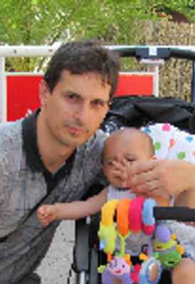
David Setién
Alejandro González
Consultor
Consultor
#running #trailrunning #mountain #CantabriaInfinita #dotnet #geek
Developer @plainConcepts
@glez4lex
@DavidSetien

Slide 5
Introducing MUTATION TESTING

Slide 6
Definition
It’s a formal software analysis technique intended to find the most effective test cases for our software through small code modifications (mutations).

Slide 7
Initial HYPOTHESES
The competent programmer hypotheses: that states most software faults introduced by experience programmers are due to small syntactic errors.
The coupling effect: that states simple faults can often cascade or couple to form other emergent faults.

Slide 8
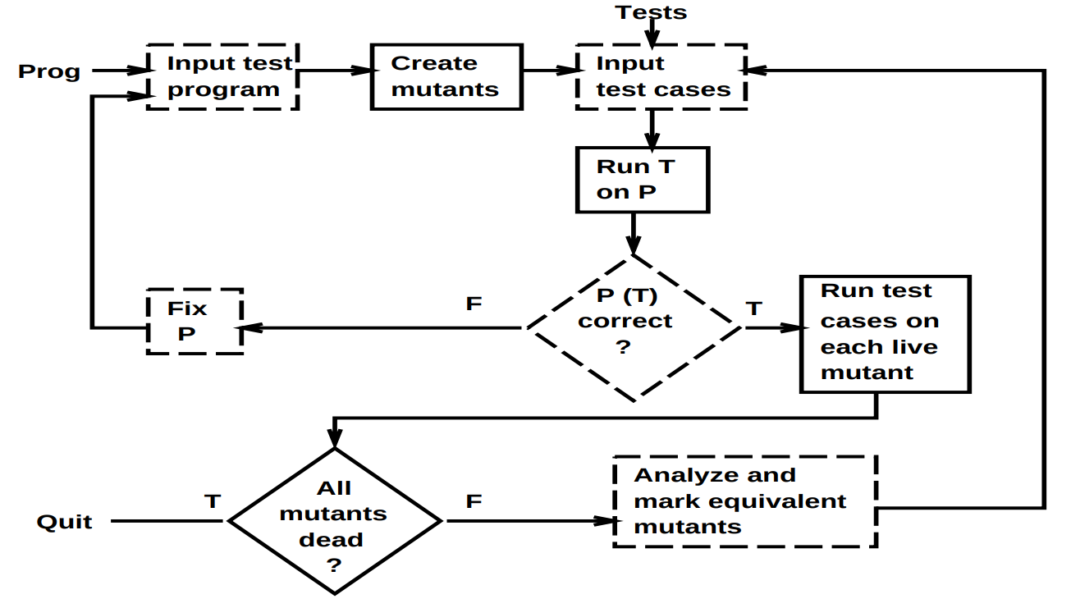
A bite of HISTORY

Slide 9
Why doing MUTATION TESTING
To assist our developers on finding the most effective test cases;
to keep an stable quality level in our software;
to avoid our users finding unforeseen scenarios;
and to keep the confidence of our customers.

Slide 10
A word about CODE COVERAGE

Slide 11
What is CODE COVERAGE
It’s a measure used to describe the degree to which the source code of a program is executed when a particular test suit runs.
Notes:
A program with high test coverage, measured as a percentage, has had more of its source code executed during testing, which suggests it has a lower chance of containing undetected software bugs compared to a program with low test coverage. Many different metrics can be used to calculate test coverage; some of the most basic are the percentage of program subroutines and the percentage of program statements called during execution of the test suite.
Test coverage was among the first methods invented for systematic software testing. The first published reference was by Miller and Maloney in Communications of the ACM in 1963.

Slide 12
The 100% CC MISTAKE
It’s a good target but beware! 100% code coverage doesn’t mean 100% code correctness.
It’s a measure of how much code has been actioned by your tests but not how many cases or scenarios.

Slide 13
An EXAMPLE
Testing a discrete code unit
{
Test
Initial state:
a = 4
b = 2
Expected result: 2
Missing Test
Initial state:
a = 1
b = 0
Expected result: !!
function (a, b: int) {
return a / b;
}

Slide 14
Mutation testing AT WORK

Slide 15
Initial STAGE
A developer writes the first bunch of tests for a given unit of code.
{
Test 1
Initial state:
a = true
b = true
Expected result:
c = 1
Test 2
Initial state:
a = false
b = false
Expected result:
c = 0
if (a && b) {
c = 1;
} else {
c = 0;
}

Slide 16
Generating MUTANTS
Applying the condition mutation operator.
Source
if (a && b) {
c = 1;
} else {
c = 0;
}
Mutant 1
if (a || b) {
c = 1;
} else {
c = 0;
}
{
Test 1
Initial state:
a = true
b = true
Expected result:
c = 1
Test 2
Initial state:
a = false
b = false
Expected result:
c = 0
Missing Test
Initial state:
a = false
b = true
Expected result:
c = 0

Slide 17
What is being TESTED
We’re trying to find incorrect tests (tests that miss the use case under test) and missing tests.

Slide 18
Mutation OPERATORS

Slide 19
The most REPRESENTATIVE
Arithmetic operator
Array declaration
Block statement
Boolean literal
Conditional expression
Equality operator
Logical operator
String literal
Unary operator
Update operator

Slide 20
Recommended READS & REFERENCES
A Practical System for Mutation Testing: Help for the Common Programmer by A. Jefferson Offutt. George Mason University.
Introduction to Software Testing by Paul Ammann and Jeff Offutt. Cambridge University Press.
Stryker Framework. @stryker-mutator
Word mutation testing. Wikipedia.org.

Slide 21
Speech MATERIALS
Mutation simple examples https://github.com/superseti/mutation-simple-examples
Robobar example https://github.com/superseti/robobar-example
Slideshow https://github.com/glezalex/mutation-testing-by-example

Slide 22
THANKS!
www.plainconcepts.com
@plainconcepts

Slide 23
Time for a DEMO

Slide 24
Next steps
Remove WebPack
Larger project
Integrate in build pipeline
Server Side

